Slide 1

MARKETING AND RETAIL ANALYTICS PROJECT - PART 1
-hiya shah

Slide 2

TABLE OF CONTENT
1. PROBLEM STATEMENT
2. EXECUTIVE SUMMARY
3. Objective
4. Data Summary
5. EXPLORATORY DATA ANALYSIS
6. Customer Segmentation using RFM analysis
7. KNIME WORKFLOW
8. Inferences from RFM Analysis and identified segments
9. RECOMMENDATION

Slide 3
PROBLEM STATEMENT
An automobile parts manufacturing company has been actively selling products to a diverse range of customers for the past three years. Despite its growth, the company lacks the in-house expertise to derive actionable insights from its transaction data. As a result, they wish to uncover hidden patterns and trends in their customer transactions. By analyzing this data, the company aims to better understand customer behavior, improve customer segmentation, and implement targeted marketing strategies. These insights will help the company not only enhance customer satisfaction but also drive revenue growth by offering more personalized and efficient services.

Slide 4
EXECUTIVE SUMMARY
We have received the 3 years data of automobile part manufacture. Consisting 2747 entries with 20 variable details regarding the demography of the product and customer information.
Agenda of this project is to find the underlying buying patterns of the customers of an automobile part manufacturer. based on the past 3 years of the Company's transaction data and recommend them customized marketing strategies for different segments of customers.

Slide 5
Objective
The primary objective of this analysis is to leverage data science techniques to:
Identify underlying patterns in customer purchasing behavior.
Segment customers based on their transactional data.
Provide actionable insights to optimize the company's marketing efforts.
Recommend personalized marketing strategies for each customer segment to maximize sales and customer retention.

Slide 6
Data Summary
The data is about an automobile parts manufacturing company. They have provided the data collected of transactions for 3 years.
The data has 2747 entries (0 To 2746) of rows and 20 columns. The data has 1 datetime64 , 2 foat64, 5 int64,and 12 Object data types.
The dataset has both no null values and no duplicate rows of data.
This data more or less reflects the purchasing behavior of customers in different categories . The company is into automobile part manufacture, and they have different product line like Classic car , Motorcycle, plane, train, ship, Bus truck, vintage cars etc.
There is presence of outliers in variables such as Quantity ordered, Price and Sales.
Variable ‘Sales’ has highest positive skewness(0.784) and Variable ‘Days_since_lastorder’ has lowest negative skewness(-0.002).
The data maintained each transactions entry as order number and for each order number maintained all required information like customer identity details , and product details like price , quantity , product code, and sales for each customer.
We noticed that one order number has many different entries with different product codes.
Manufacturer's Suggested Retail Price(MSRP) for each product code is decided but we found that this is not matching with Price of Each item & is inconsistent with MSRP.

Slide 7
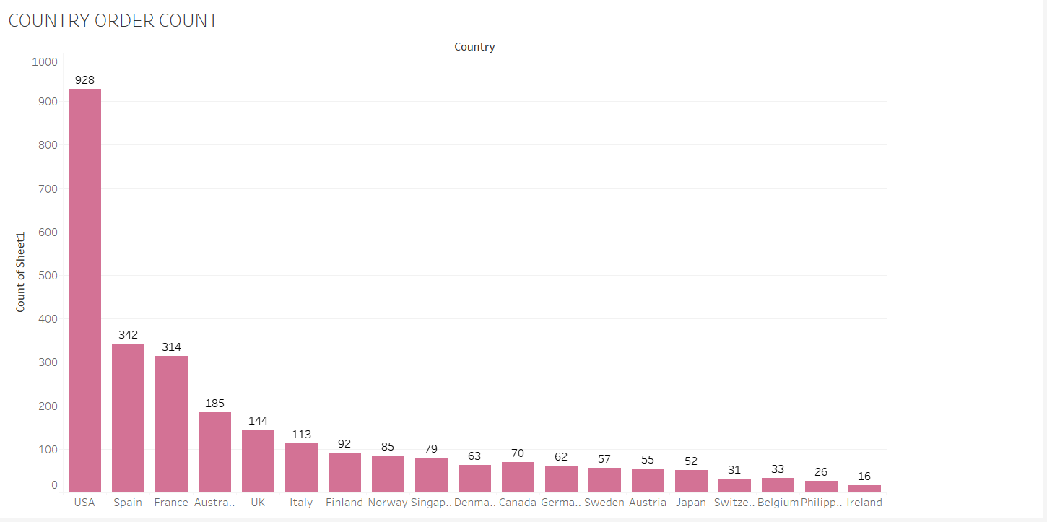
EXPLORATORY DATA ANALYSIS- Univariate, Bivariate, and multivariate analysis using data visualization
Using boxplot on sales & status variable we have plotted univariate analysis. We can clearly see that outlier is present there. Also using histogram on sales variable we did univariate analysis. For Categorical variable like product line we also did univariate analysis using bar plot.

Slide 8
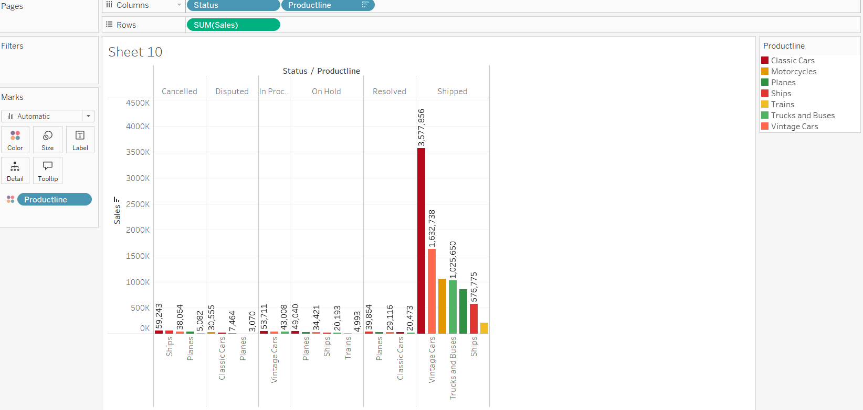
Analysis on Sales, Country, Deal Size, Quantity order, Product line and MSRP

Slide 9
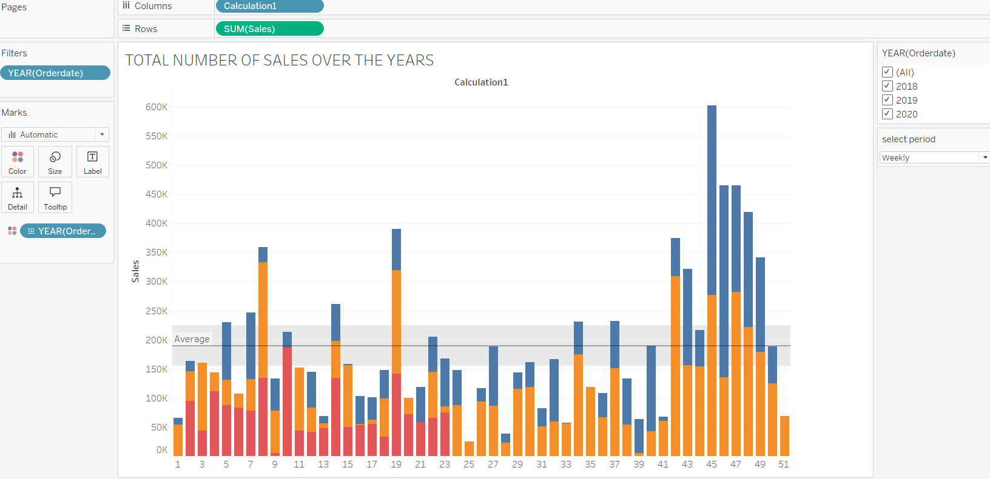
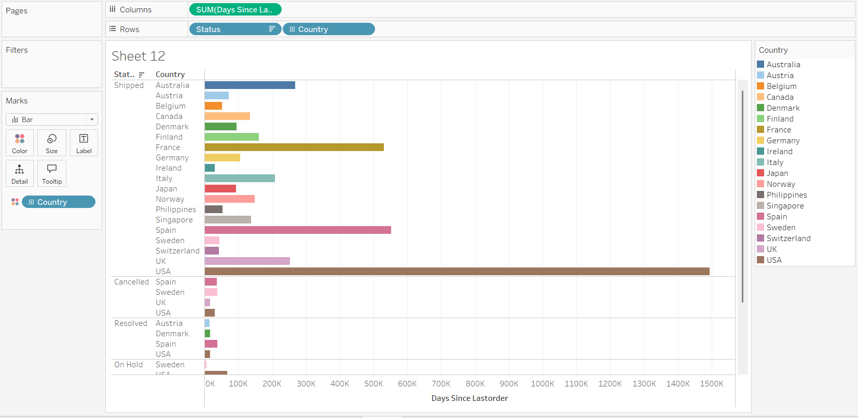
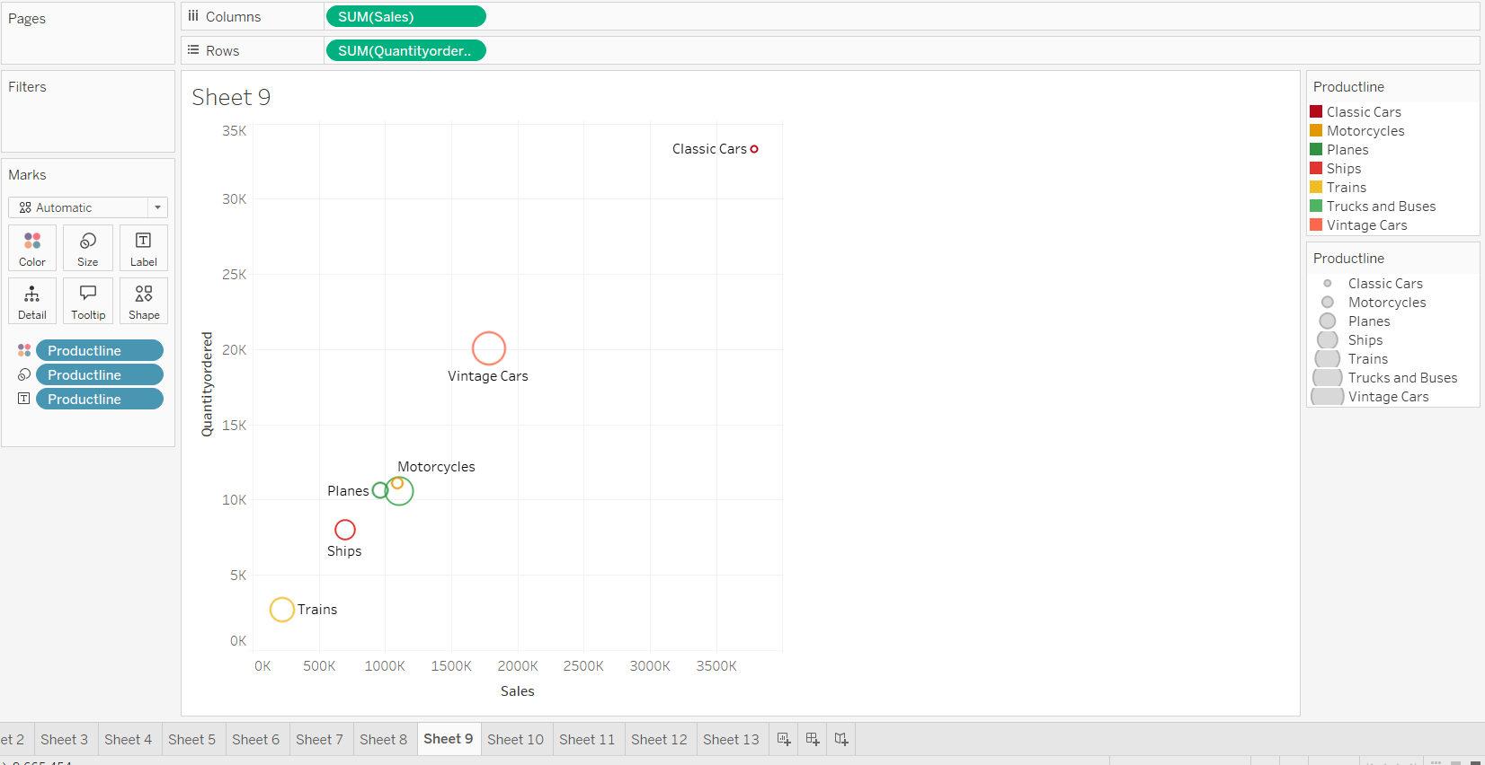
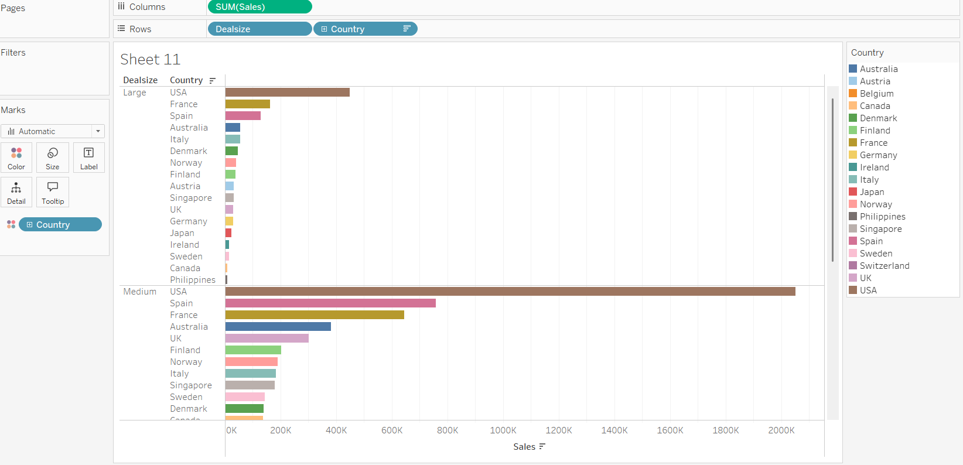

Slide 10
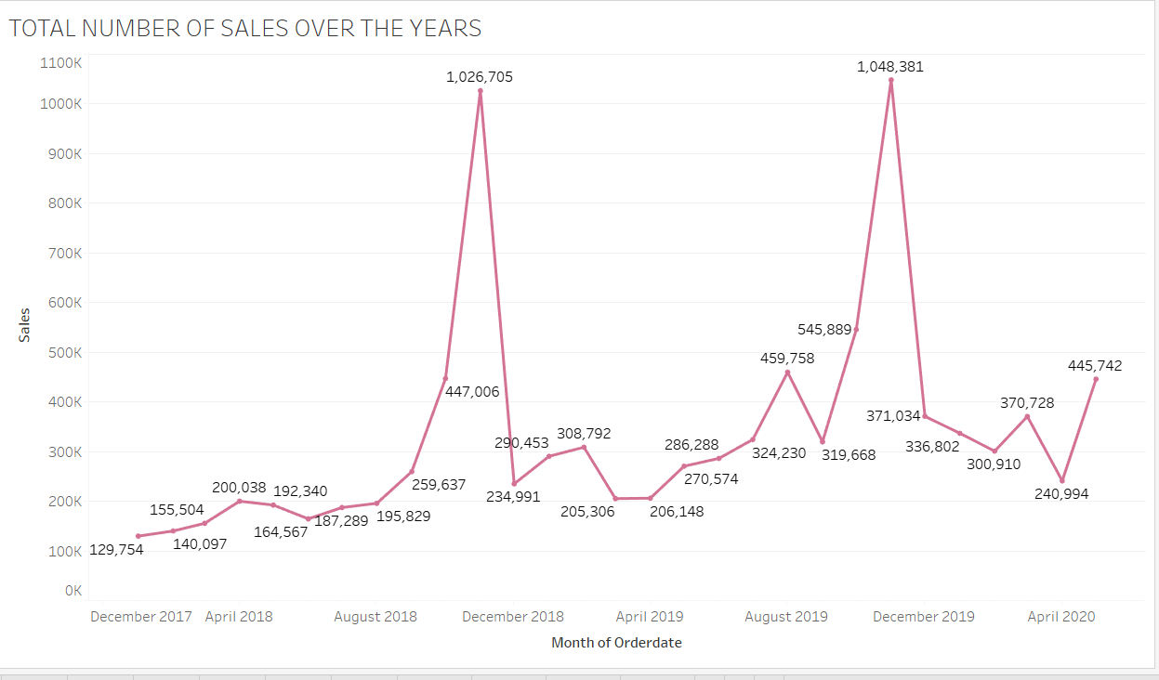
Yearly, Quarterly, monthly, Weekly time series analysis & its trend are been shown. We observed that in Last quarter sales are high as compared to other quarters. There is a seasonality seen.

Slide 11
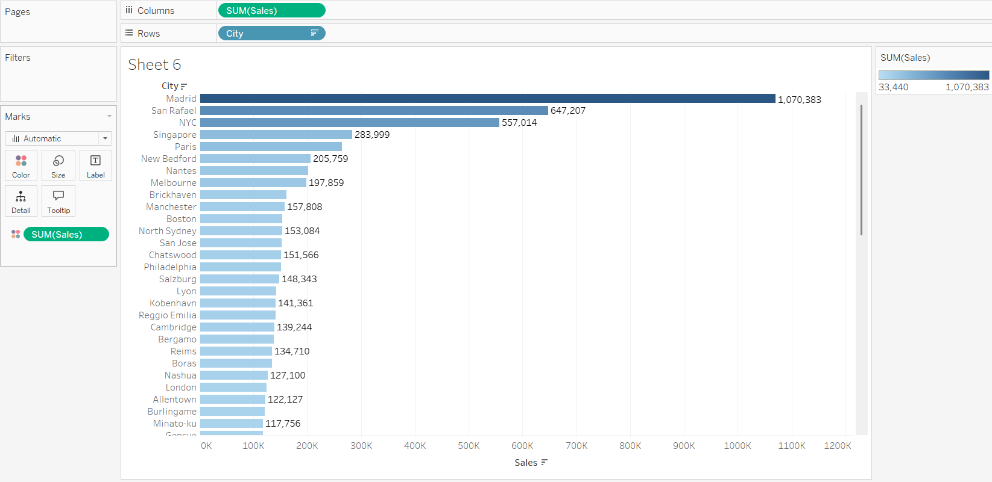
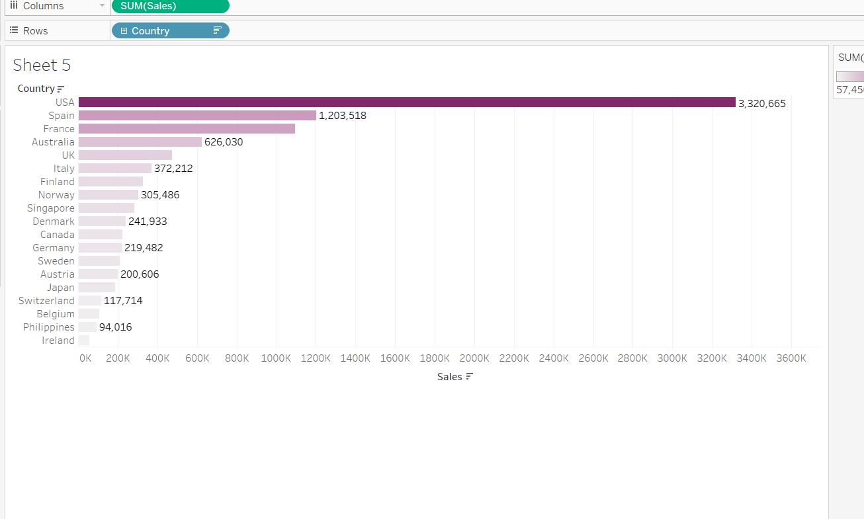
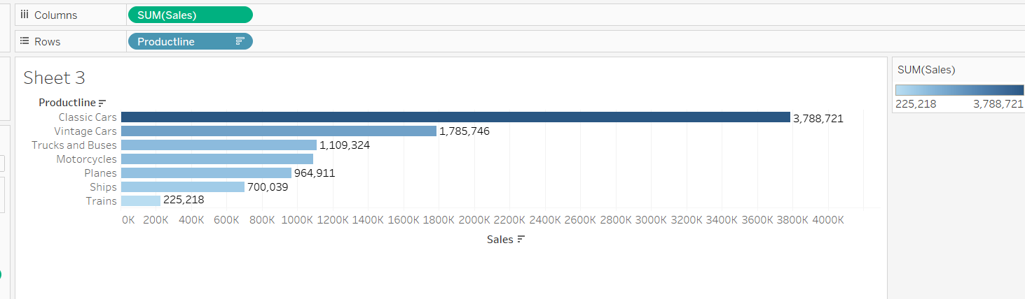

Slide 12
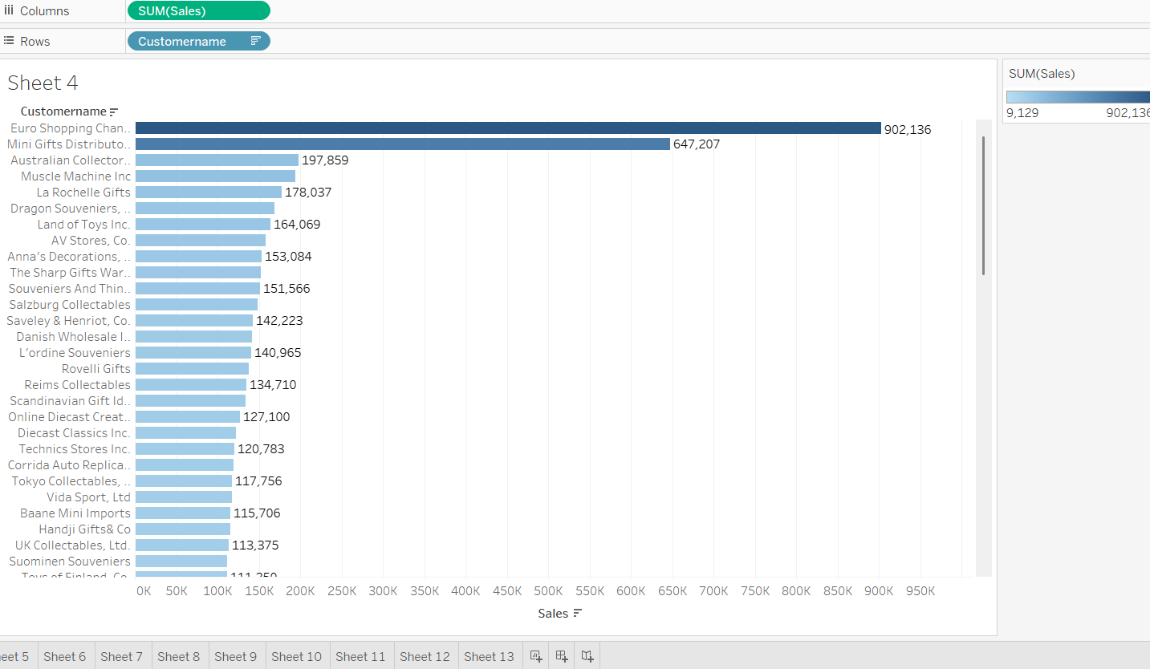

Slide 13
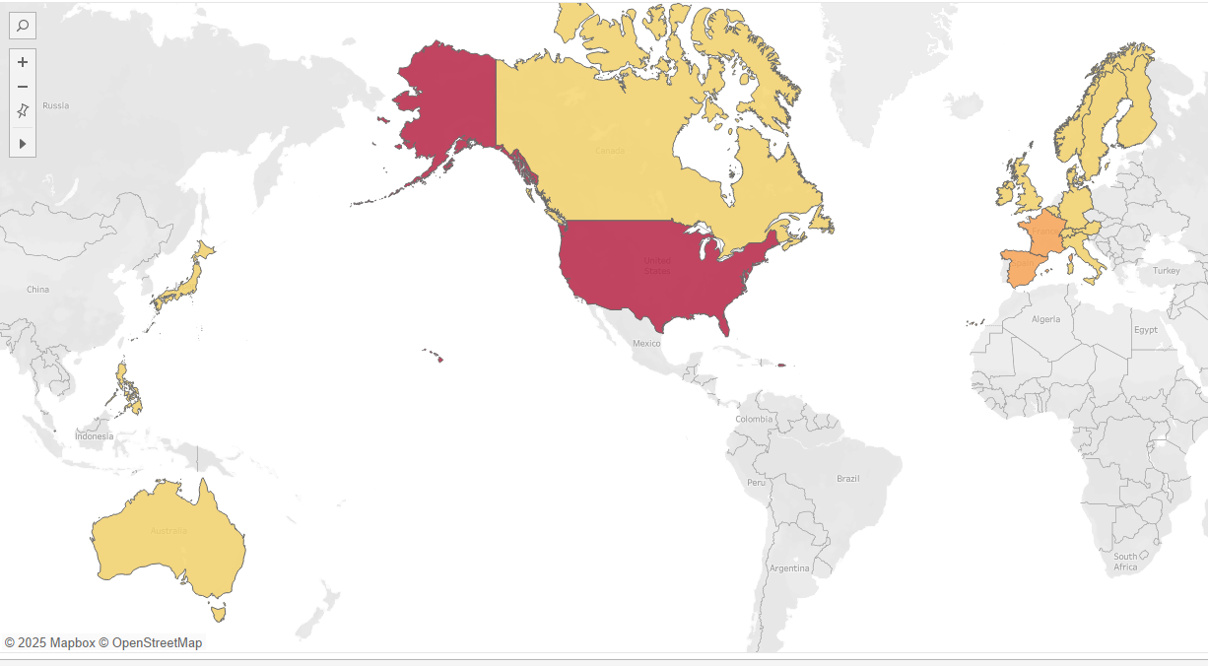
Country Wise Quantity ordered
USA has the highest count of customers(32) and Ireland has the least count of customers(1).
Also USA has the highest quantity ordered, in which San Rafael, NYC holds the highest record.

Slide 14
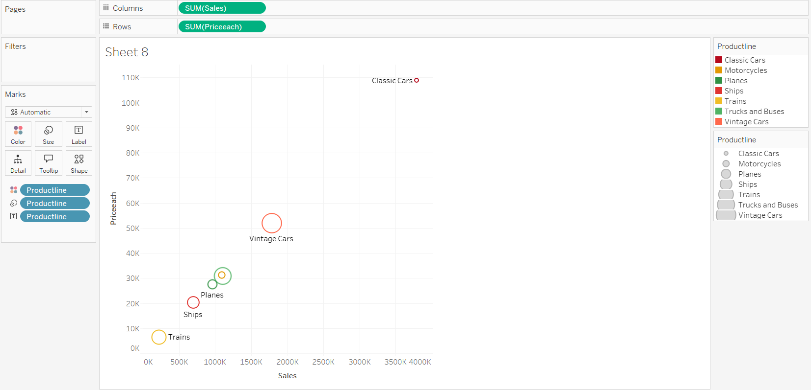

Slide 15
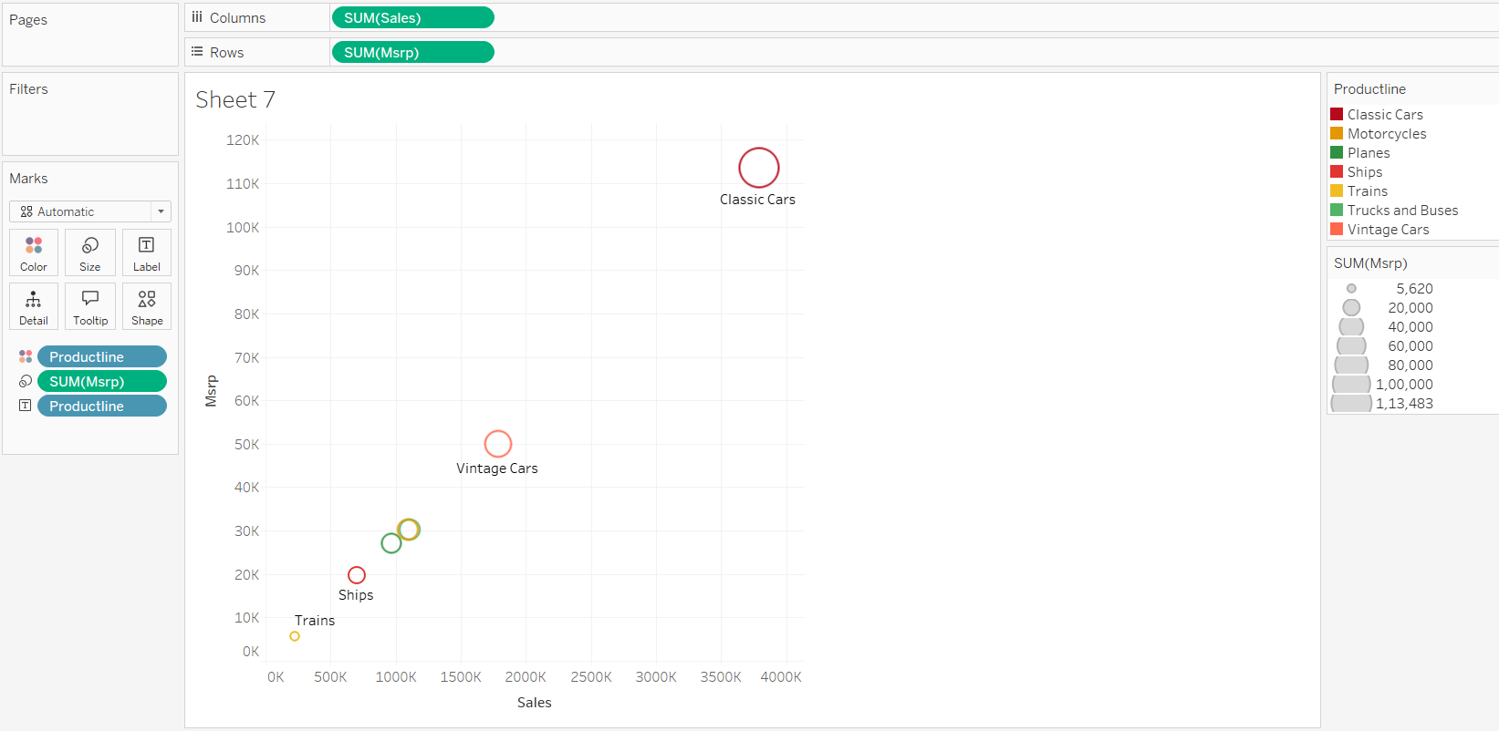

Slide 16
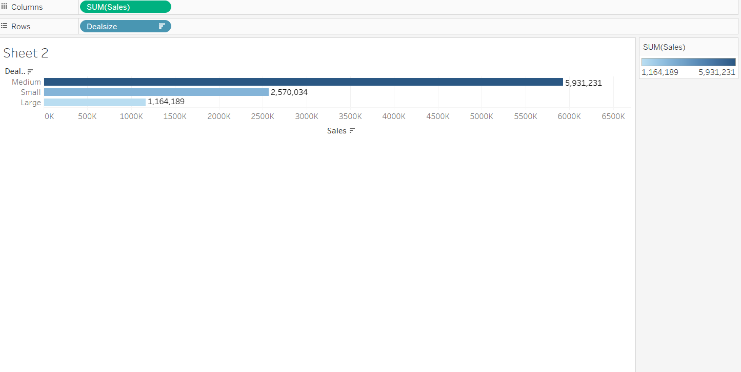

Slide 17
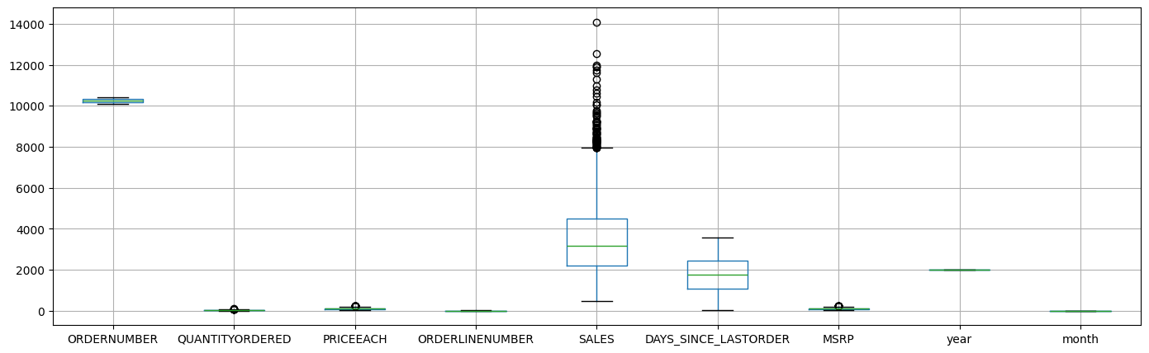

Slide 18
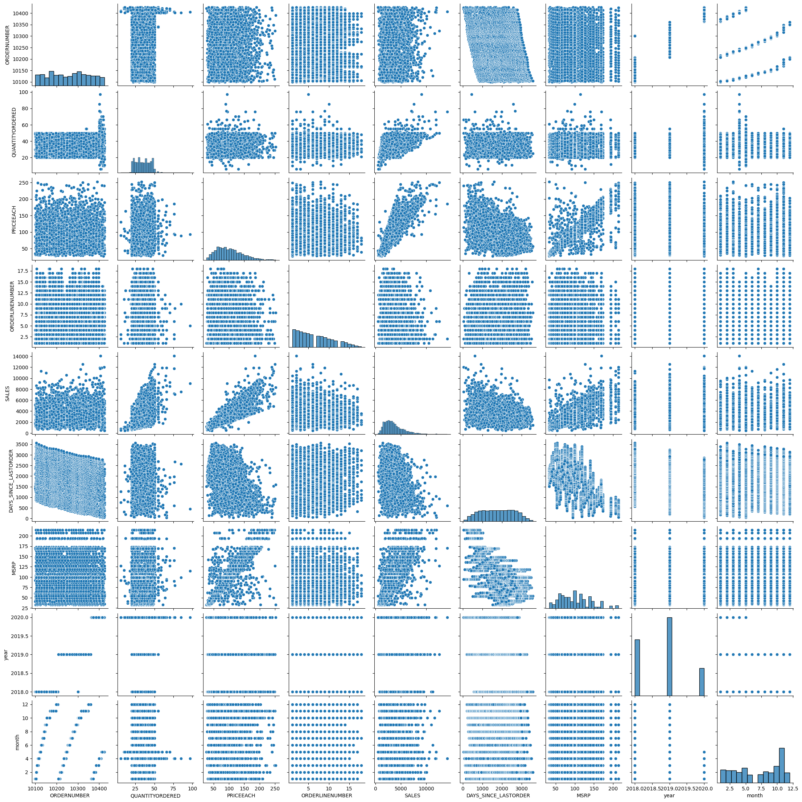
Variables ‘Sales’ and ‘Price each’ have highest positive Correlation(0.81) and Variables ‘Days_since_lastorder’ and ‘MSRP’ have highest negative Correlation(-0.52)
From the plot , we can see that none of the variables are symmetric.
Variables ‘Sales’ and ‘Price each’ have almost linear relation ship between them.
From the plots , we can see there is higher spread of data along the trend line for MSRP compared to Price each. So we need to maximize sales by identifying respective items for which there is higher price change.

Slide 19
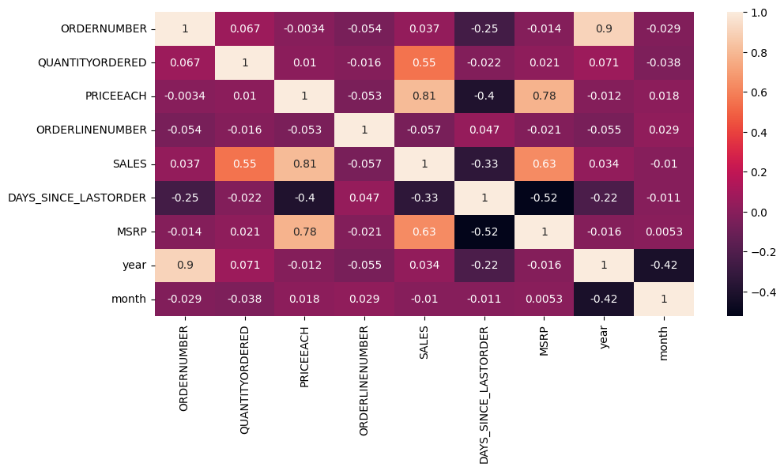
Overview of the Heatmap:
This is a correlation matrix, showing pairwise Pearson correlation coefficients between different variables in a dataset—likely sales or order data.
Since recency (DAYS_SINCE_LASTORDER) is negatively correlated with sales, initiate post-purchase engagement campaigns to retain active customers.
The negative correlation between DAYS_SINCE_LASTORDER and PRICEEACH/MSRP suggests lost customers were spending more.
The negative correlation between year and month could indicate shifting demand patterns across years.

Slide 20
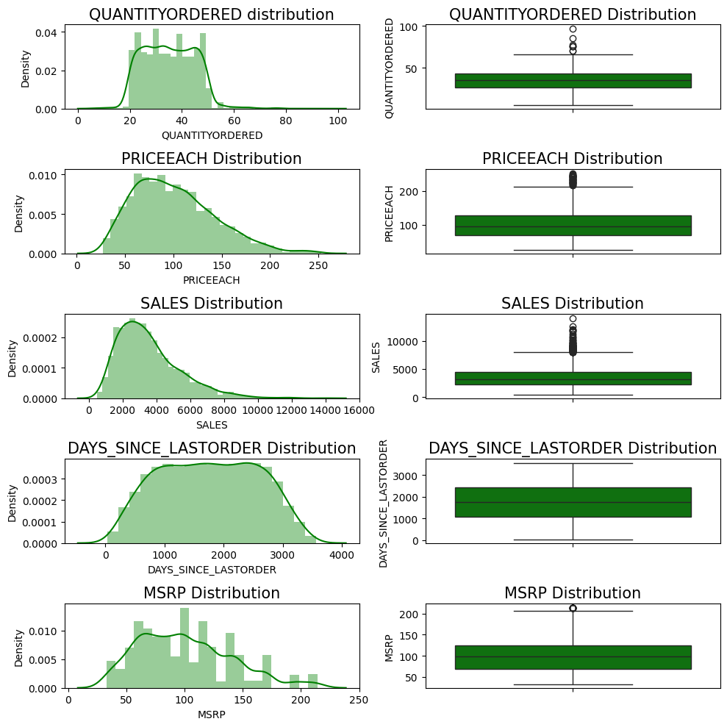
Variable-Wise Summary & Insights
Feature | Skewness | Outliers Present | Suggested Action
QUANTITYORDERED | Mild | Yes | Cap/winsorize
PRICEEACH | Moderate | Yes | Log transform / bin
SALES | Strong | Yes | Log-transform, segment
DAYS_SINCE_LASTORDER | Uniform | Minor | Bucketize
MSRP | Moderate | Yes | Bin or scale

Slide 21
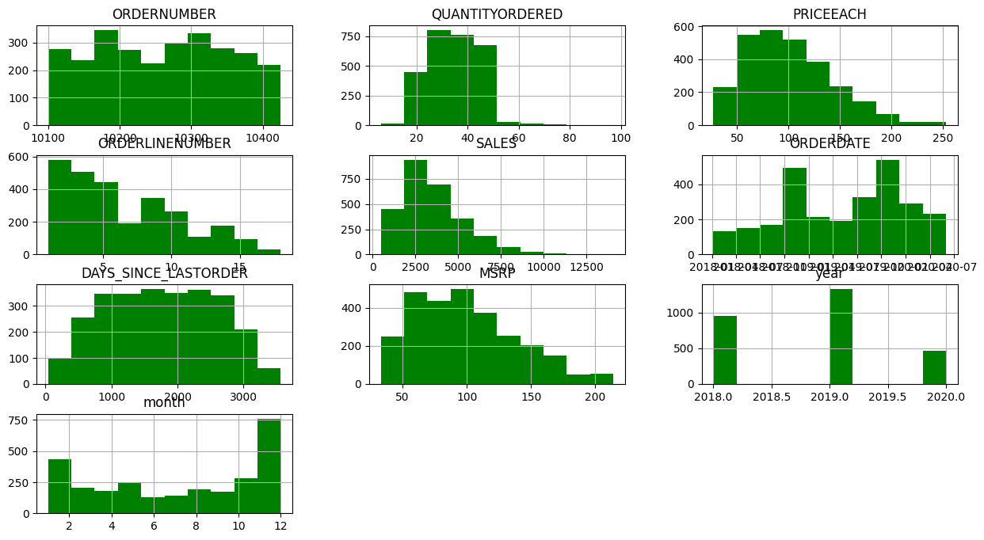

Slide 22
Boxplot Analysis: Distribution & Outlier Insights
1. SALES:
Highly skewed with many outliers (visible as black circles).
Values spread widely from the lower whisker (~500) to the upper (~8000), with many points beyond it.
2. DAYS_SINCE_LASTORDER:
Wide range and few outliers — indicates varied customer return intervals. Central values suggest customers mostly return in a 1000–2500 day range.
3. MSRP, PRICEEACH, QUANTITYORDERED:
All show tight interquartile ranges (IQRs) with some minor outliers.
Distributions are relatively compact, but a few values spike.
4. ORDERNUMBER & ORDERLINENUMBER:
ORDERNUMBER is tightly clustered around ~10,000.
ORDERLINENUMBER is stable; no outliers, compact range.These are categorical or indexed variables, so boxplot utility here is limited.
5. year & month:
No visible variability; these are clearly time-based.All data points in year are close (likely 1–2 years), and month varies only 1–12.

Slide 23
INSIGHTS
Using histogram on sales variable, we did univariate analysis.
For categorical variable like product line we did univariate analysis using bar plot.
Using boxplot on sales, product line, deal size variable we have plotted bivariate analysis.
Using MSRP, Price each, status, sales & product line variables we did multivariate analysis.
After doing the analysis, we can see there is a high demand of classis cars followed by vintage cars and the least is for trains.
The sales are high for the last Quarter of the year.
The demand for classic cars are so high that the company have sold the product below MSRP giving the customers a good discount.
And Vintage were sold above MSRP.

Slide 24
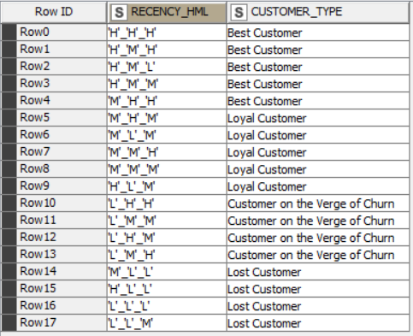
Customer Segmentation using RFM analysis
Customer Segmentation done by using KNIME and MS Excel by dividing the data based on Recency, Frequency and Monetary variables through grouping data by variable ‘Order Number’.
As per the suggestion about ignoring the column "Days Since last order" .
created new column name Recency as "[Max(order date) - order date)]"We have assumed “30-05-2020“ as a reference date and created recency column.
If we can see the data there are same order number repeated for different product Code. So we can assume count of each order number as frequency of an order number.
In SALES column we get sales amount for each transaction. We can use SALES parameter and using an assumption of sum of aggregation we created a new column as Monetary
Then created four different bin for each Recency, frequency & Monetary using percentile range(0,0.10, 0.70,100).Based on above 4 bin assumption we have considered 4 segments like Loyal , Best , Lost and the customers on the verge of Churn.

Slide 25
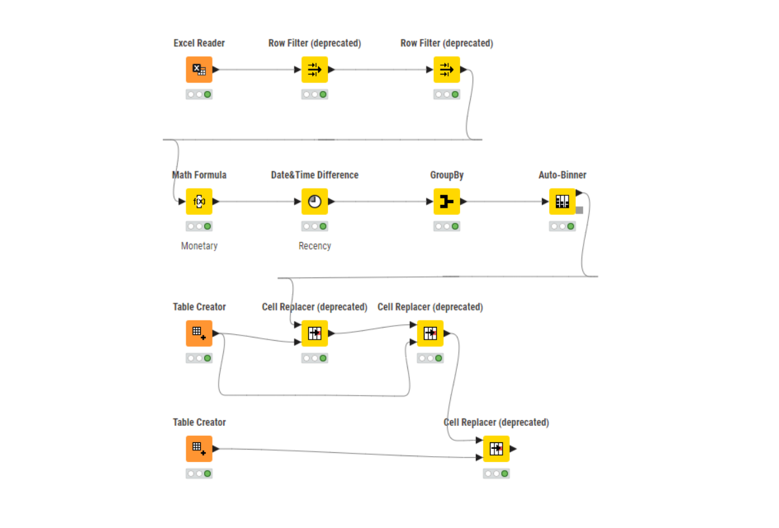
KNIME WORKFLOW and Output table Image-

Slide 26
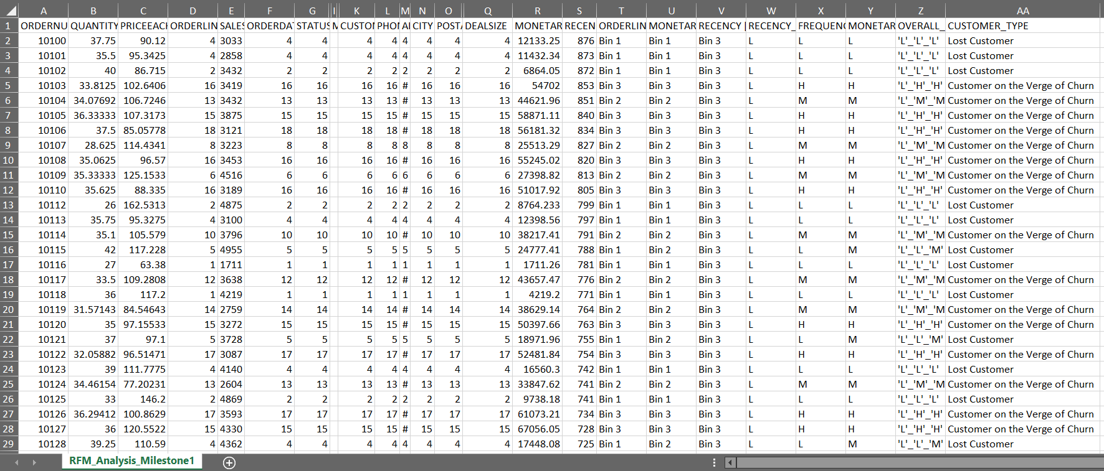

Slide 27
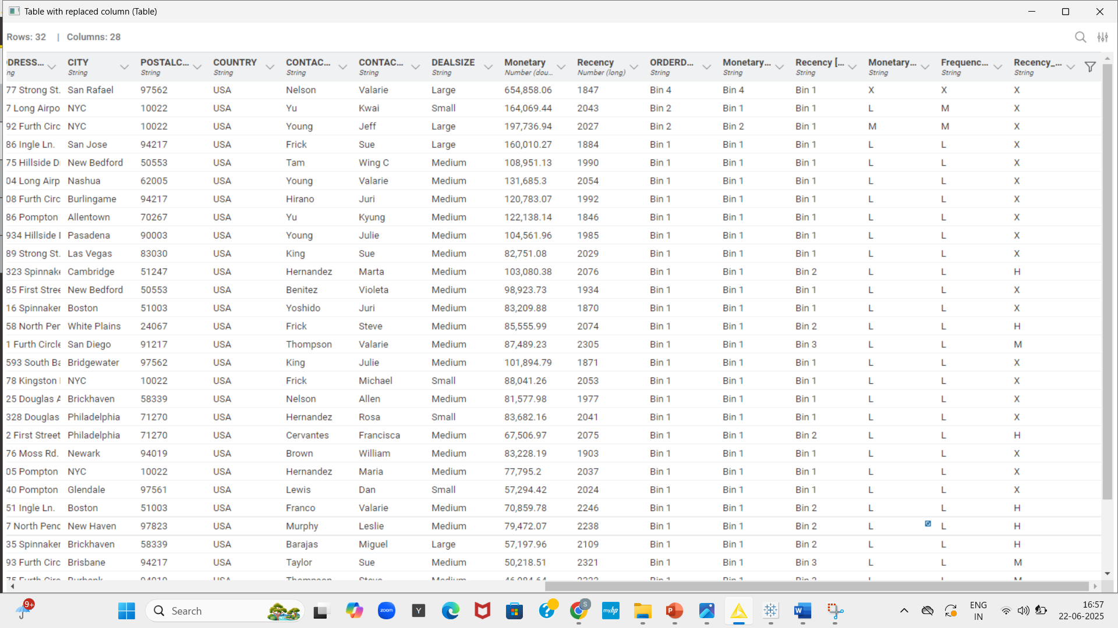

Slide 28
Inferences from RFM Analysis and identified segments
BEST CUSTOMER:
On basis on Recency, frequency & monetary we have grouped our top customers.
We have given the most significance to recency parameter as these customers has recently purchased our products.
Also according to RFM model the most important is given to recency. Hence we have kept it as our first parameter for selecting top customers for e.g. Customer number -10181,10182, 10185
We should not loose these customers at any cost as they are the biggest contributors of the business.

Slide 29
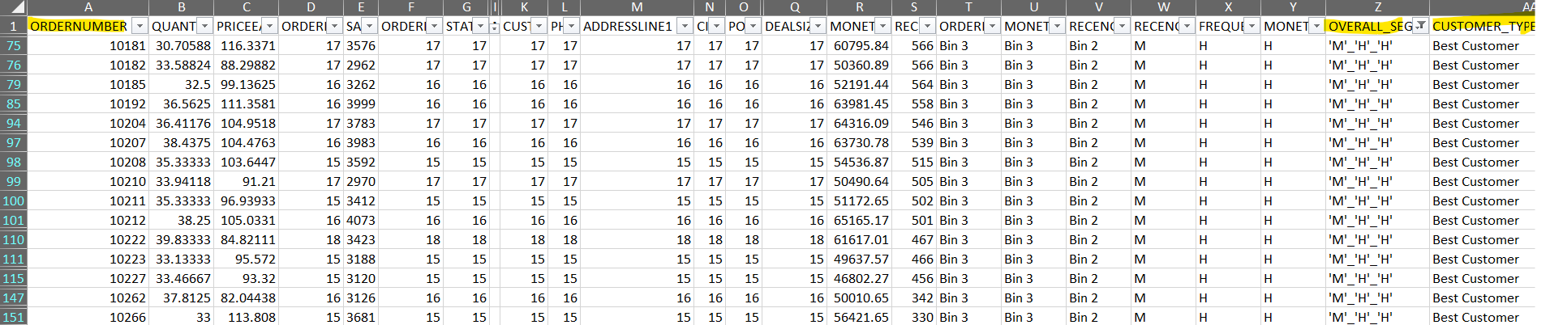

Slide 30
Inferences from RFM Analysis and identified segments
LOYAL CUSTOMER:
On basis on Recency, frequency & monetary we have grouped our loyal customer's. These customers have purchased multiple times with good monetary value.
If we focus more on this segment of customers, we can easily turn them into our top best customers too. Also, in this segment we can see the customers for product line - classic cars are many.
These are the still valuable customers as they are with better level in all aspects Frequency and Monetary. We have to look after the needs of these customers to bring them into the pool of best.

Slide 31
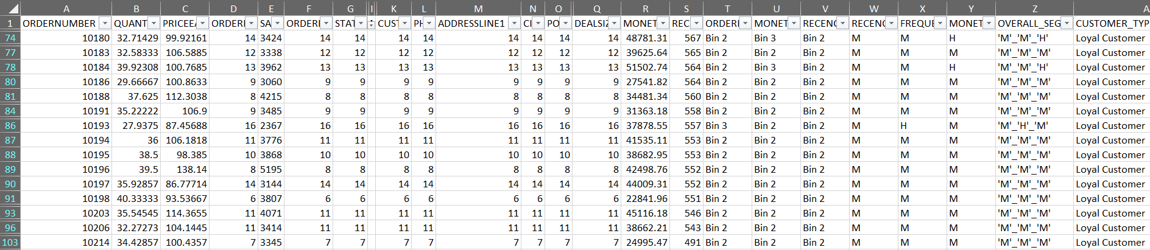

Slide 32
Inferences from RFM Analysis and identified segments
LOYAL CUSTOMER:
On basis on Recency, frequency & monetary we have grouped our loyal customer's. These customers have purchased multiple times with good monetary value.
If we focus more on this segment of customers, we can easily turn them into our top best customers too. Also, in this segment we can see the customers for product line - classic cars are many.
These are the still valuable customers as they are with better level in all aspects Frequency and Monetary. We have to look after the needs of these customers to bring them into the pool of best.

Slide 33
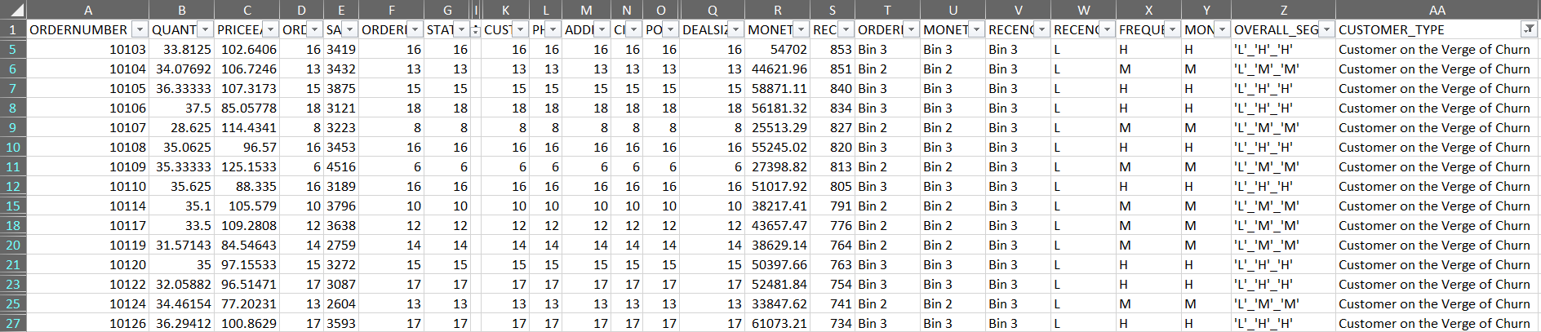

Slide 34
Inferences from RFM Analysis and identified segments
CUSTOMERS ON THE VERGE OF CHURN:
On basis on Recency, frequency & monetary we have grouped our Customers who are on verge of churning. We should definitely focus on this group before we lose them and try to convert them into our regular customers.
For e.g. 10103, 10104– Their frequency is good with good monetary value, but low recency made them stand in this group. If the company pays more attention and fulfill their requirement, then we can easily turn them into our regular customer and we can save them from churning out.
We can still concentrate on them to increase business as they have got High Recency level.

Slide 36
Inferences from RFM Analysis and identified segments
LOST CUSTOMERS :
On basis on Recency, frequency & monetary parameters we have grouped our Customers who we’d lost
Their recency is very low and hasn’t made any purchase since long. So we can say these are our lost customers. If taken feedback from them and fulfill their demand we might bring them back to been a good customer.
But suggestion is to not to invest much time on these type of customers.
As these are the most avoidable customers as they are with lowest level in all aspects Recency, Frequency and Monetary. There is no point in spending time and effort to maintain business with these customers.

Slide 37
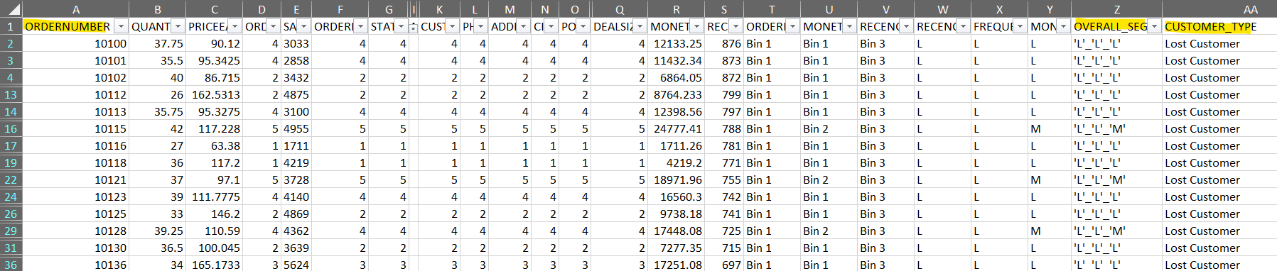

Slide 38
RECOMMENDATION:
Using Recency, frequency & monetary parameters we have grouped our Top , loyal, on the verge of churning and lose customers. Customers with good recency has been our top customers were as we also have lost customer lists.
Customers on verge of churning can be saved and can be converted into a good buyer.
RFM model is used for deriving the customers types like Loyal, top or best, on verge of churning & lost customers.
Recency, frequency & monetary parameters were widely used to bifurcate the types of customer's.
This model can be very helpful to the company to maintain its sales and customers and can focus on how the company has lost the customers & can take various actions to bring them back.
It is vital for the company to convert the customers who are on verge of churning into a regular customer or at least maintain them.
And also how to increase the sales ratio can be identified.

Slide 39
THANK YOU
HIYA SHAH
PGP DATA SCIENCE
AND
BUSINESS ANALYTICS

